Slide 1


Getting Started with Kubernetes & Rancher Kubernetes Engine (RKE)
Rancher Labs
#rancherk8s

Slide 2


K8s Installation
All roads lead to Rome, and for the same there are so many k8s installation methods exist
Single-node installation
Manual cluster installation
Automatic cluster installation
Managed clusters
Kubernetes the hard way

Slide 3
RKE & Kubernetes - better together
Open source container manager used to run Kubernetes in production
Simplified installation for deployment k8s configuration just using YAML
Automated deployment of the latest k8s release
Automated Operation to Workload, RBAC, policy, and project management
Vendor Independence mean’s not a specific vendor operating system and safe for upgrade
24x7 enterprise-grade support
Infrastructure management across multiple clusters and clouds
Rancher Kubernetes Distribution
Certified and supported distribution that closely follows the upstream Kubernetes project

Slide 4
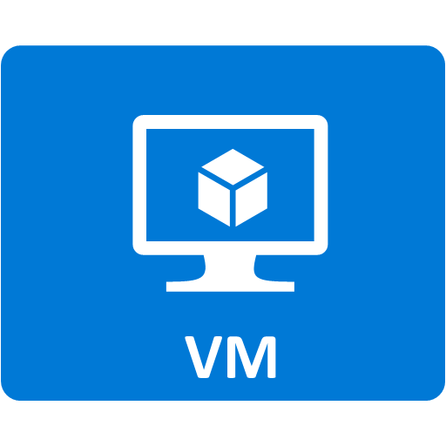


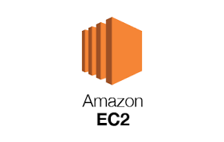


RKE Support Platform

Slide 5
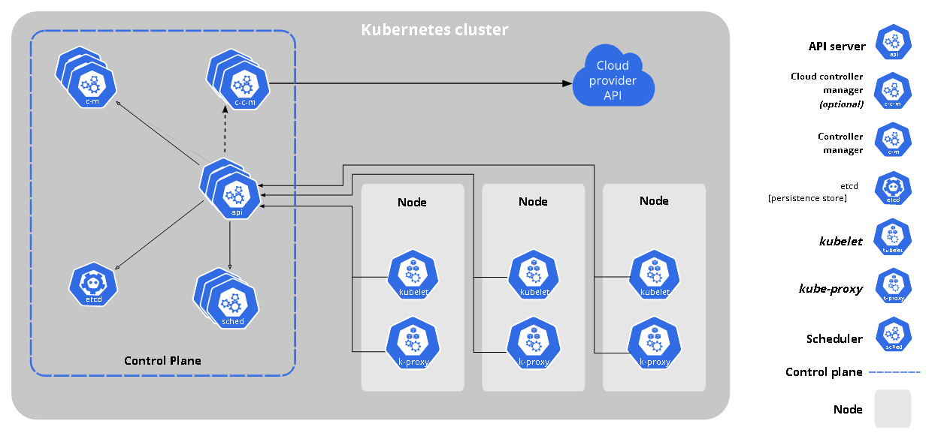
K8s Detail Architecture

Slide 6
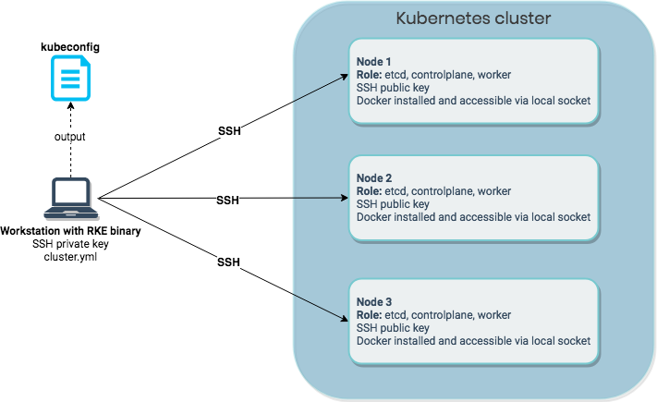

RKE Architecture
Our Lab 3 Control Plane (Master), 2 worker node, 1 workstation

Slide 7


RKE Lab
https://github.com/i3training/about-k8s-rnd/tree/main/RKE-Lens

